Slide 1

QnQ
FRANCHISE

Slide 2

SUMMARY
A Pharma QnQ franchise is a business model in which a pharmaceutical company grants a license to another party to sell its products and services in a designated area.
In this model, the franchisee is accountable for the marketing, sales, and distribution of the products within their assigned territory.

Slide 3









CONTENTS
Install the app
Sign-up
About us
Profile
Personal details
Bank details
Franchise request details
Franchise image

Slide 4
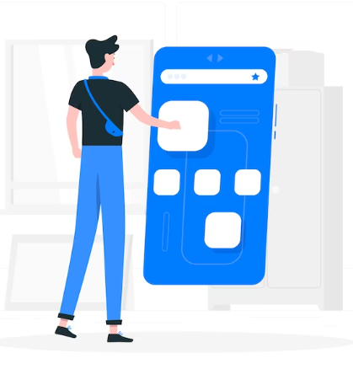
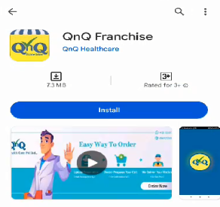
INSTALL THE APP
Open the Google Play Store.
Search for "QnQ Franchise" in the Google Play Store.
Install the app on your device.

Slide 5
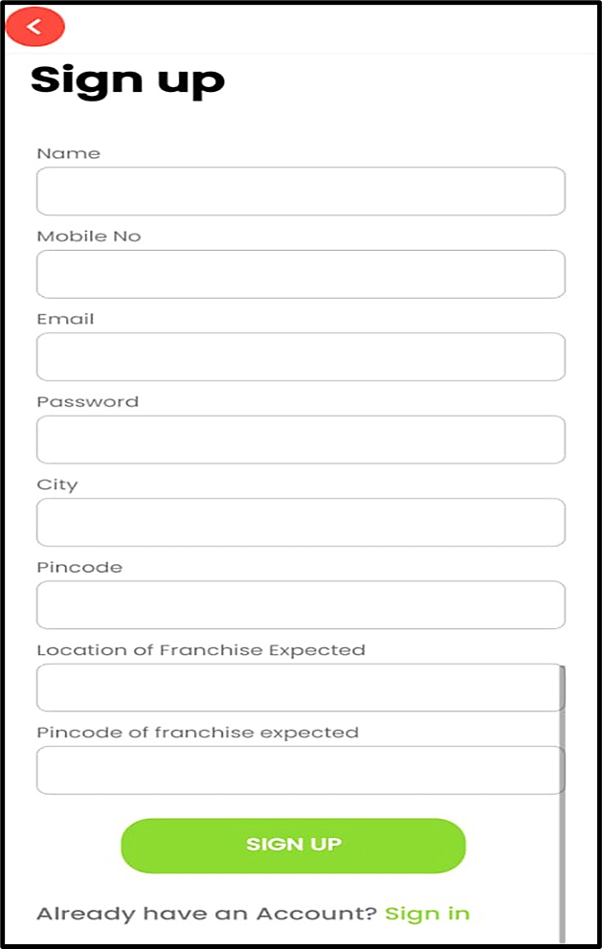
SIGN-UP
If you have an account, sign in with your email and password.
For new users, please complete the account details form below.
Name
Mobile no
Email
Password
City
Pin code
Location of franchise expected.
Pin code of franchise expected.

Slide 6


ABOUT US
After successfully signing up, users are welcomed with the 'About Us' section, where our "Vision and Mission" are highlighted.

Slide 7
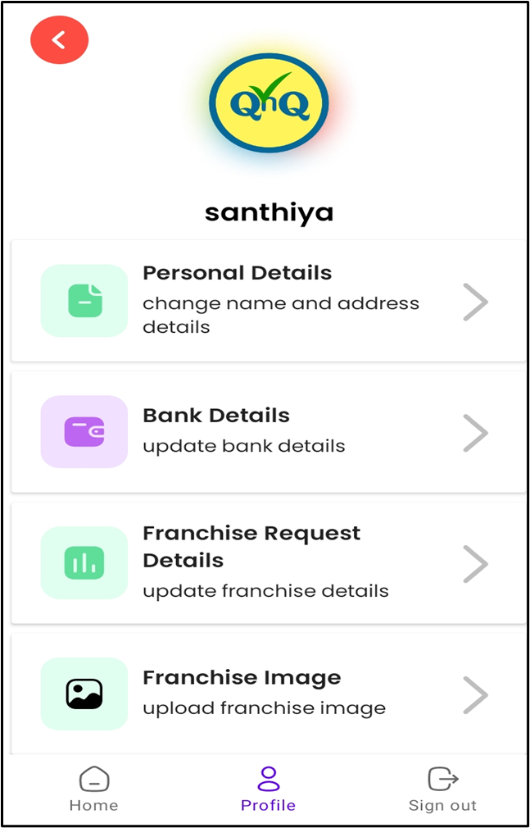

PROFILE
After 'About Us,' it displays 'Profile,' and below it shows 'Personal Details,' 'Bank Details,' 'Franchise Request Details,' and 'Franchise Images.'

Slide 8
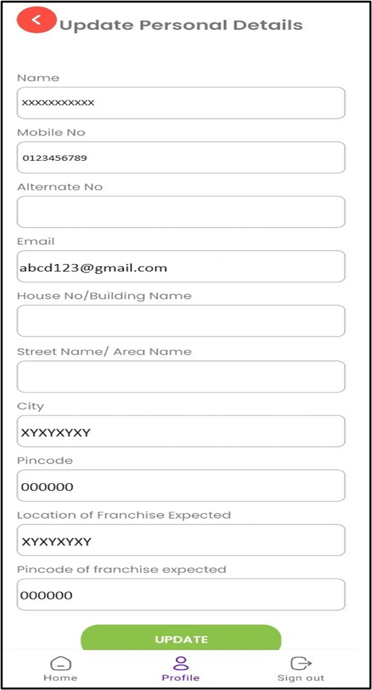
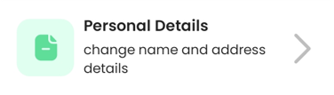
PERSONAL DETAILS
To access the 'Personal Details' section above, click on the bar.
It will take you to the 'Update Personal Details' enquiry form.
Enter the required form details and proceed with the update.

Slide 9
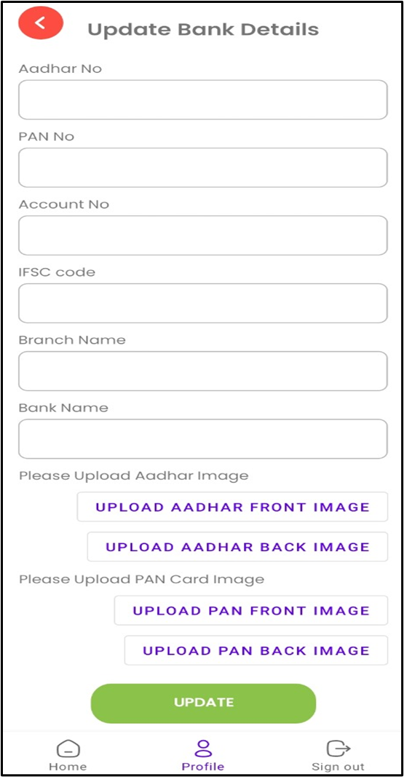
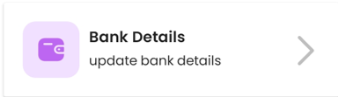
BANK DETAILS
To access the 'Bank Details' section above, click on the bar.
It will take you to the 'Update Bank Details' form.
Enter the necessary details such as account number, PAN number, Aadhaar number, etc., and proceed with the update.

Slide 10
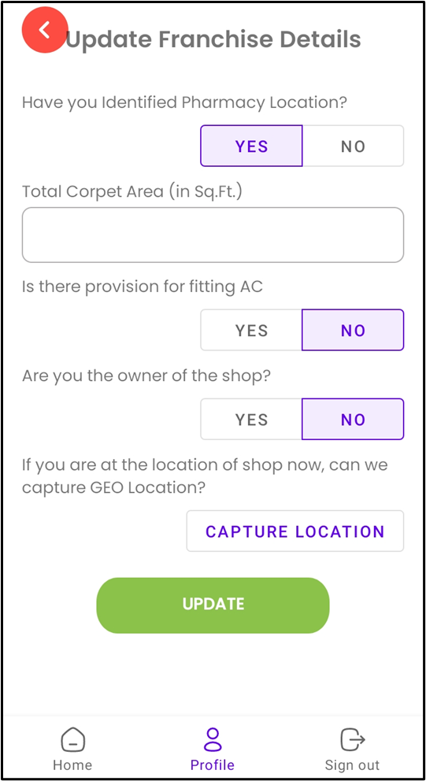

FRANCHISE REQUEST DETAILS
To access the 'Franchise Request Details' section above, click on the bar.
It will take you to the 'Update Franchise Details' form.
Enter the required information by selecting options such as location identification, carpet area, AC fitting, etc., and proceed with the update.

Slide 11
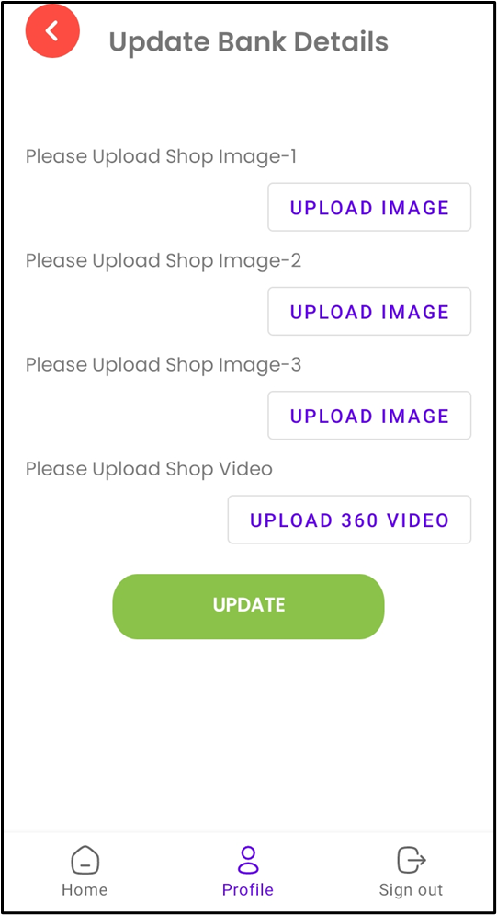

FRANCHISE IMAGES
After completing the above details, go to 'Franchise Images.’
To access the 'Franchise Images' section above, click on the bar.
It will take you to the 'Update Bank Details' form.
Enter and upload the franchise's images and videos, then proceed with the update.

Slide 12

SUCCESSFUL
Once the above details are fully completed and uploaded, it is the "Franchise Team or Assistant" who will reach out and contact you.

Slide 13

THANK YOU!

